Slide 1
Water Management Portal

Slide 2
Introduction:
Provide an application which allows residents and visitors of a city to find out more about water management-related aspects about the city. Aspects include information about water supply and waste water management for the city. The site might also provide real-time information about flooding, water supply handling (boil-water alert), water-related work projects (water supply repair, waste water treatment, etc.).
The application could also provide information about water management-related studies and/or projects that the city is working on. Anything from measured bacteria and contaminant levels in rivers and streams, water supply, and waste water egress to new water management projects and their status, to water management analysis and reports. The site could also provide safe water use instructions, what to look for, what to avoid, and so on.Support resident and visitor feedback for a variety of items: water supply pressure issues, water quality concerns, water pollution incidents, or submit a suggestion for improvement.

Slide 3
Present Working System :
This System contains no updated information about water management in the city.
This Means Don’t knows about the particular water supply timings in the city.
Citizens Don’t Know about Current working project in the city.
Citizens don’t know about water Quality Reports information.
Citizens Don’t know about Anything from measured bacteria and contaminant levels in rivers and streams
Citizens Don’t know about safe water use instructions
Citizens don’t have proper communication to send complaints, Queries, Feedbacks.
Citizens don’t have water supply pressure issues, water quality concerns, water pollution incidents.

Slide 4
To Be Proposed :
The development of this new system contains the following activities, which try to automate the entire process keeping in the view of database integration approach.
The application provides information’s for water management in the city.
The application provides information’s water supply and waste water management for the city.
The application also provide real-time information about flooding, water supply handling (boil-water alert),
The application provides information’s water-related work projects (water supply repair, waste water treatment, etc.)

Slide 5
The application provides also provide information about water management-related studies and/or projects that the city is working on.
The application provides Anything from measured bacteria and contaminant levels in rivers and streams, water supply, and waste water egress to new water management projects and their status, to water management analysis and reports
The application site could also provide safe water use instructions, what to look for, what to avoid, and so on.
This system maintains user’s personal, address, and contact details.
Authentication is provided for this application only registered users can access.
Report generation features is provided using to generate different kind of reports.

Slide 6
Users of the System :
Administrator
City Employees
Citizens
Visitors

Slide 7
Modules of the System
Administrator Module
City Employees(Sub Administrator) Module
Water Management Module
Authentication
Reports

Slide 8
Administrator:
Water Management Studies:
Add Water Management Studies Information
View Water Management Studies Information
Enquiry
Post Water Information Enquiry.
View Water Information Enquiry All Cities

Slide 9
Water Management Regional’s:
States
Add New State Name
View State
Update State name
Delete State Name
District
Add District Names
View District Names
Delete District Names
Update District Names
City
Add New City Information With Map
View All Cities Information.
Update City Information
Delete City Information

Slide 10
City Employees:
Tips & Suggessitions:
Post Tips for City Citizens.
View Tips of City Posted By Citizens.
Complaints
Post Complaints about City.
View Complaints of City Posted By Citizens.
Give Solutions for Posted Complaints.
Feedbacks:
Post feedback about city on particular event
View feedbacks of City Posted By Citizens.
Delete feedbacks of the city.

Slide 11
Water Management Module
Water Supply
Add City Water Supply Timings(Area, Division wise and Contact Details)
View Add City Water Supply Timings
Update Add City Water Supply Timings
Delete Add City Water Supply Timings
Floods
Add real time floods Information
View floods Information.
Update floods Information.
Delete floods Information.

Slide 12
Water Management Projects
Add Projects(Waste water Management Project like…etc)
View Projects
Change Project information and status
Delete Projects Information.
Bacteria Containments in rivers and streams
Add Bacteria Containments in rivers and streams
View Bacteria Containments in rivers and streams
Delete Bacteria Containments information.
Water management analysis and reports:
Add water Management Analysis and reports.
View water Management Analysis and reports.
Delete water Management Analysis and reports.

Slide 13
Water safe water usage instructions:
Add safe water usage instructions
View safe water usage instructions
Delete safe water usage instructions
Water Quality Concerns:
Add Water Quality Concerns
View Water Quality Concerns
Delete Water Quality Concerns

Slide 14
Security and Authentication:
Login
Logout
Sub Admin(City Employees)Registration, Citizen Registration
Change Passwords
Forget Password
View Profiles
Update Profiles

Slide 15
Reports
Generating Different Format report to be download (.xls, pdf, html, txt)

Slide 16
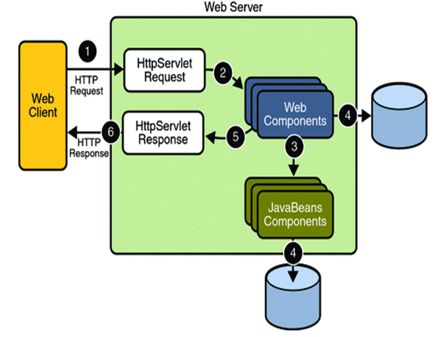
SYSTEM REQUIREMENT SPECIFICATION :

Slide 17
PROCESS FLOW:
THE PRESENTATION LAYER:
Also called as the client layer comprises of components that are dedicated to presenting the data to the user. For example: Windows/Web Forms and buttons, edit boxes, Text boxes, labels, grids.
THE BUSINESS RULES LAYER:
This layer encapsulates the Business rules or the business logic of the encapsulations. To have a separate layer for business logic is of a great advantage. This is because any changes in Business Rules can be easily handled in this layer. As long as the interface between the layers remains the same, any changes to the functionality/processing logic in this layer can be made without impacting the others. A lot of client-server apps failed to implement successfully as changing the business logic was a painful process

Slide 18
Process Flow:
THE DATA ACCESS LAYER:
This layer comprises of components that help in accessing the Database. If used in the right way, this layer provides a level of abstraction for the database structures. Simply put changes made to the database, tables, etc do not affect the rest of the application because of the Data Access layer. The different application layers send the data requests to this layer and receive the response from this layer.
THE DATABASE LAYER:
This layer comprises of the Database Components such as DB Files, Tables, Views, etc. The Actual database could be created using SQL Server, Oracle, Flat files, etc. In an n-tier application, the entire application can be implemented in such a way that it is independent of the actual Database. For instance, you could change the Database Location with minimal changes to Data Access Layer. The rest of the Application should remain unaffected

Slide 19
Functional Requirements:
Technologies:
J2EE: Application Architecture.
Oracle 10g: Database.
My Eclipse 8.6: Development Tool.
Tomcat: Web Server.
Star UML: Design Tool.
Overview
SRS will include two sections.
Overall Description will describe major components of the system, interconnection and external interfaces.
Specific Requirements will describe the functions of actors, their role in the system and constraints.
Product Perspective
The web pages (XHTML/JSP) are present to provide the user interface on customer client side. Communication between customer and server is provided through HTTP/HTTPs Protocols.
The Client Software is to provide the user interface on system user client side and for this TCP/IP protocols are used.

Slide 20
System Interfaces:
Client on Intranet:
Client Software, Web Browser, Operating System (any)
Web Server:
Tomcat, Operating System (any)
Data Base Server:
Oracle, Operating System (any)
Development End:
My Eclipse (J2EE, Java, servlets, JSP), Oracle, OS (Windows), Web server.
Communication Interface
Client on Internet will be using HTTP/HTTPS Protocol.
Client on intranet will be using TCP/IP protocol.

Slide 21
Non Functional Requirements:
Performance Requirements:
Some of the attributes of software that relate to the ease of porting the software to other host machines and/or operating systems.
This may include:
Java is used to develop the product. So it is easiest to port the software in any environment.

Slide 22
Maintainability:
The user will be able to reset all options and all stored user variables to default settings.
Reliability:
Some of the attributes identified for the reliability is listed below:
All data storage for user variables will be committed to the database at the time of entry.
Data corruption is prevented by applying the possible backup procedures and techniques.
Usability requirements:
Some of the usability requirements identified for this system are listed below:
A logical interface is essential to an easy to use system, speeding up common tasks.
Error prevention is integral to the system and is provided in a number of formats from sanity hacks to limiting free-text input.

Slide 23
Availability:
All cached data will be rebuilt during every startup. There is no recovery of user data if it is lost. Default values of system data will be assigned when necessary
Software System Attributes:
There are a number of attributes of software that can serve as requirements. It is important that required attributes by specified so that their achievement can be objectively verified. The following items provide a partial list of examples.
The input system will allow for inputting numbers, operands, special symbols and letters of the alphabet.

Slide 24
FEASIBILITY STUDY:
TECHNICAL FEASIBILITY:
Evaluating the technical feasibility is the trickiest part of a feasibility study. This is because, at this point in time, not too many detailed design of the system, making it difficult to access issues like performance, costs on (on account of the kind of technology to be deployed) etc. A number of issues have to be considered while doing a technical analysis.
Understand the different technologies involved in the proposed system:
Before commencing the project, we have to be very clear about what are the technologies that are to be required for the development of the new system.
Find out whether the organization currently possesses the required technologies:
Is the required technology available with the organization?
If so is the capacity sufficient?
For instance –
“Will the current printer be able to handle the new reports and forms required for the new system?”

Slide 25
OPERATIONAL FEASIBLITY:
Proposed projects are beneficial only if they can be turned into information systems that will meet the organizations operating requirements. Simply stated, this test of feasibility asks if the system will work when it is developed and installed. Are there major barriers to Implementation? Here are questions that will help test the operational feasibility of a project:
Is there sufficient support for the project from management from users? If the current system is well liked and used to the extent that persons will not be able to see reasons for change, there may be resistance.
Are the current business methods acceptable to the user? If they are not, Users may welcome a change that will bring about a more operational and useful systems.
Have the user been involved in the planning and development of the project?
Early involvement reduces the chances of resistance to the system and in
General and increases the likelihood of successful project.
Since the proposed system was to help reduce the hardships encountered. In the existing manual system, the new system was considered to be operational feasible.

Slide 26
ECONOMIC FEASIBILITY:
Economic feasibility attempts 2 weigh the costs of developing and implementing a new system, against the benefits that would accrue from having the new system in place. This feasibility study gives the top management the economic justification for the new system.
A simple economic analysis which gives the actual comparison of costs and benefits are much more meaningful in this case. In addition, this proves to be a useful point of reference to compare actual costs as the project progresses. There could be various types of intangible benefits on account of automation. These could include increased customer satisfaction, improvement in product quality better decision making timeliness of information, expediting activities, improved accuracy of operations, better documentation and record keeping, faster retrieval of information, better employee morale.

Slide 27
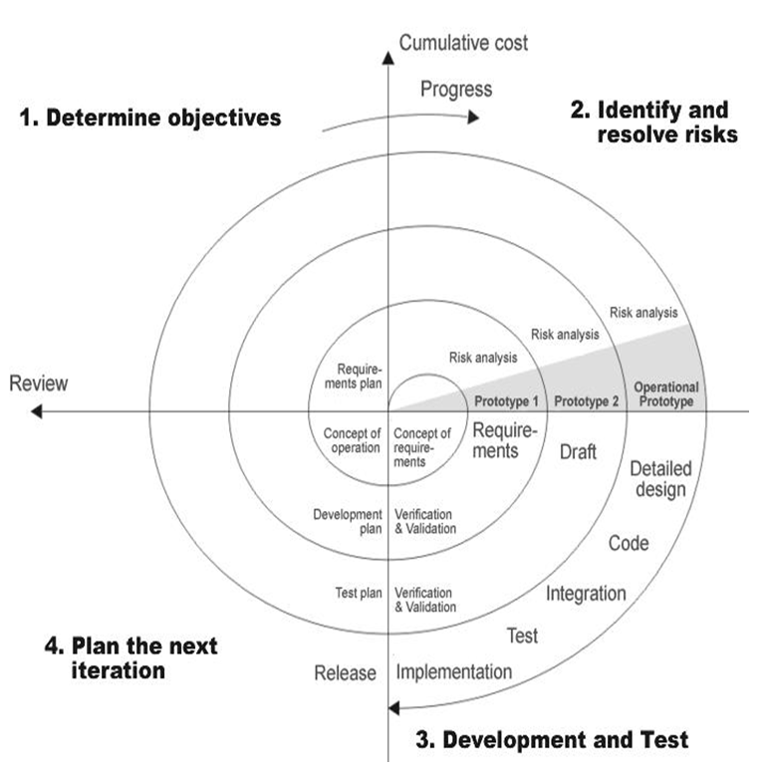
SPIRAL MODEL:

Slide 28
Applications:
Spiral Model is very widely used in the software industry as it is in synch with the natural development process of any product i.e. learning with maturity and also involves minimum risk for the customer as well as the development firms. Following are the typical uses of Spiral model:
When costs there is a budget constraint and risk evaluation is important.
For medium to high-risk projects.
Long-term project commitment because of potential changes to economic priorities as the requirements change with time.
Customer is not sure of their requirements which is usually the case.
Requirements are complex and need evaluation to get clarity.
New product line which should be released in phases to get enough customer feedback.
Significant changes are expected in the product during the development cycle.

Slide 29
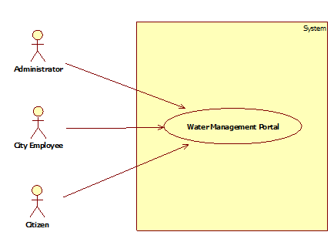
UML DIAGRAM: System Use Case Diagram:

Slide 30
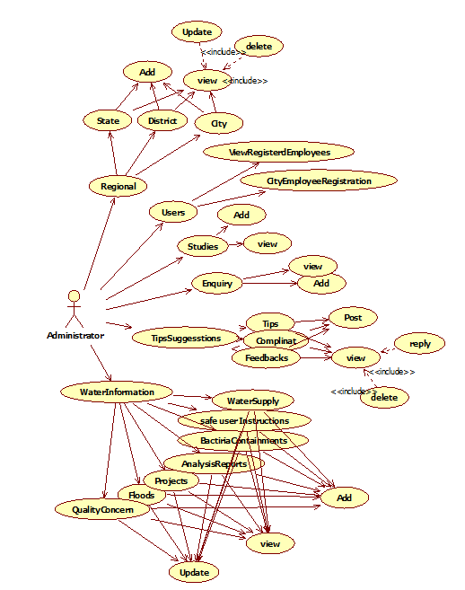
Administrator Use Case Diagram:

Slide 31
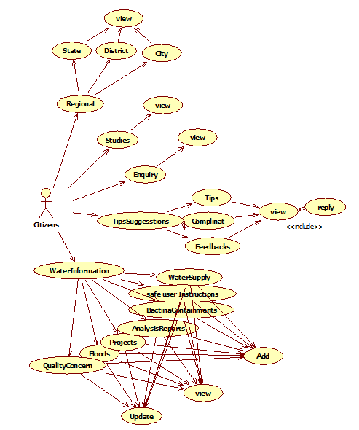
City Employee Use Case Diagram:

Slide 32
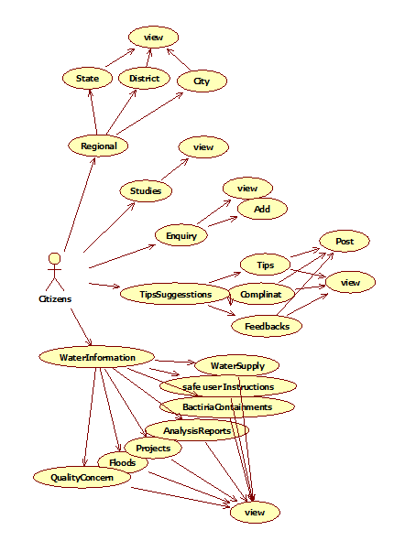
Citizen Use Case Diagram :

Slide 33
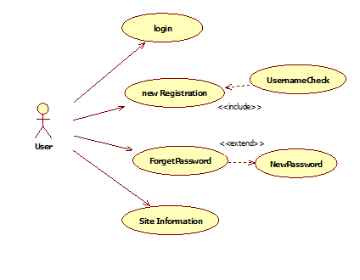
User Use Case Diagram:

Slide 34
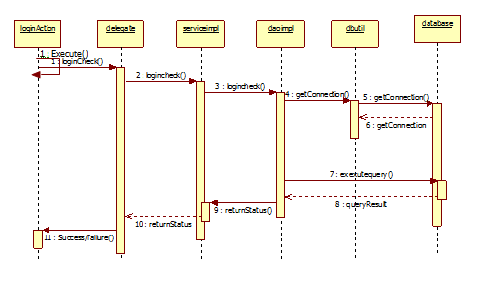
Login Sequence Diagram :

Slide 35
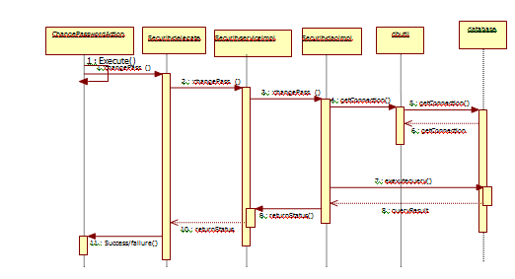
ChangePassword Sequence Diagram :

Slide 36
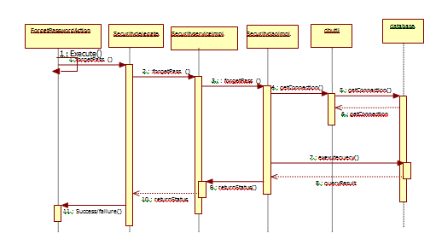
ForgetPassword:

Slide 37
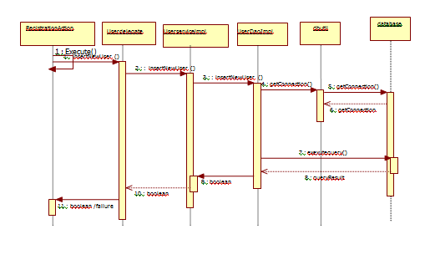
Registration Secquence Diagram :

Slide 38
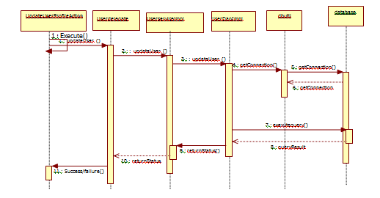
Update UserProfile Sequence Diagram :

Slide 39
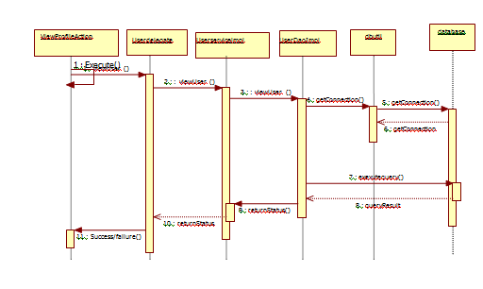
View User Profile Sequence Diagram :

Slide 40
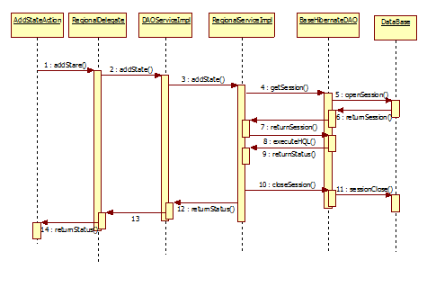
Add State Action Sequence Diagram :

Slide 41
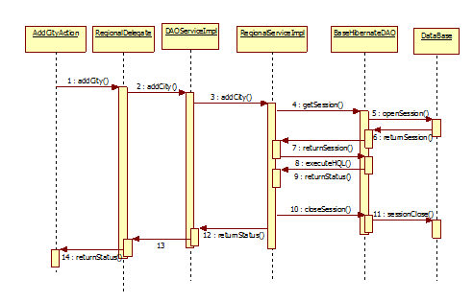
Add City Sequence Diagram:

Slide 42
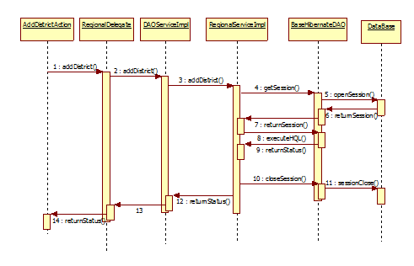
Add District Sequence Diagram:

Slide 43
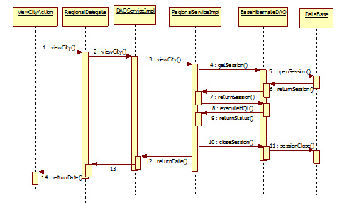
View City Sequence Diagram:

Slide 44
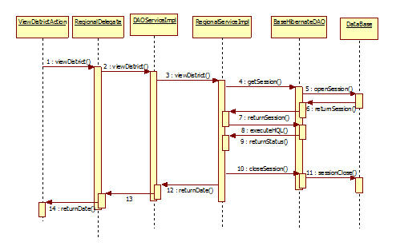
View District Sequence Diagram:

Slide 45
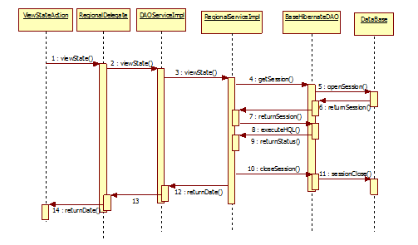
View State Sequence Diagram:

Slide 46
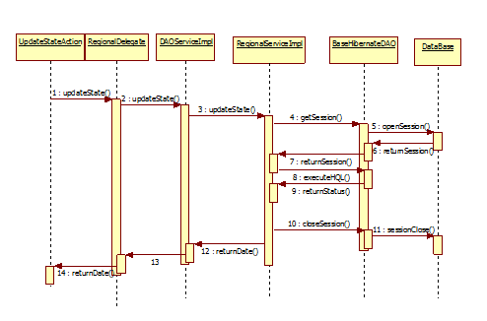
Update State Sequence Diagram:

Slide 47
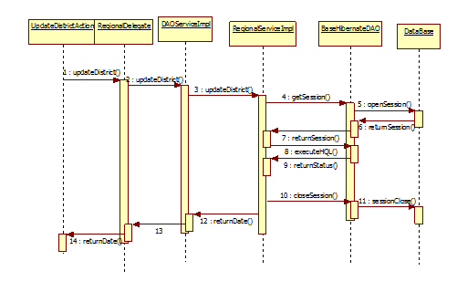
Update District Sequence Diagram:

Slide 48
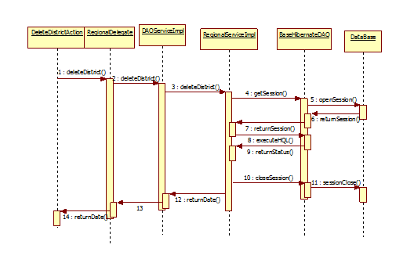
Delete District Sequence Diagram

Slide 49
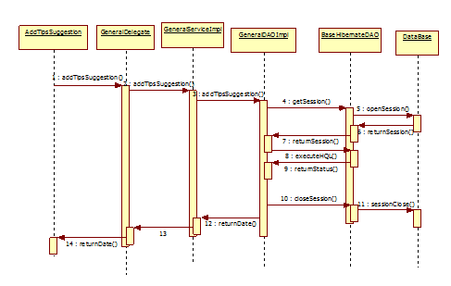
Add Tips Suggesstion Sequence Diagram

Slide 50
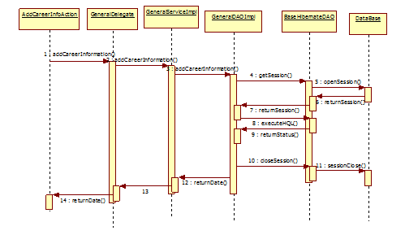
Add Career Information Sequence Diagram:

Slide 51
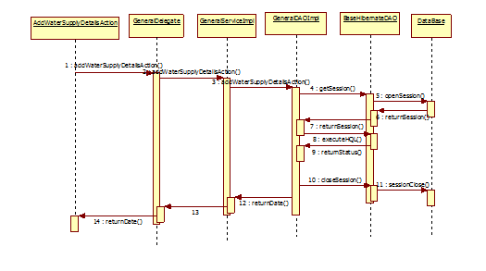
Add water Supply Sequence Diagram

Slide 52
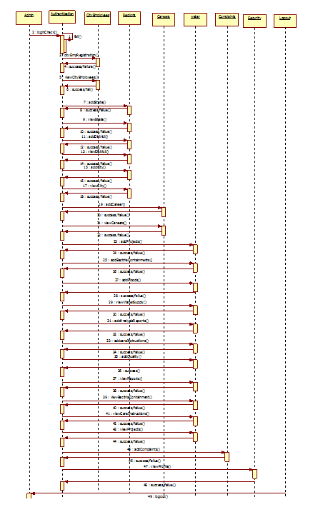
Water Supply Sequence Diagram:

Slide 53
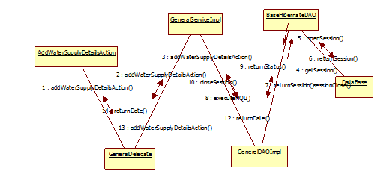
Add Water Supply Details Collaboration Diagram

Slide 54
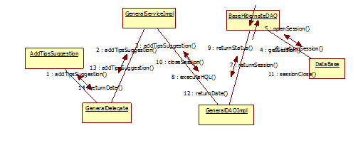
Add Tips Suggestion Details Collaboration Diagram

Slide 55
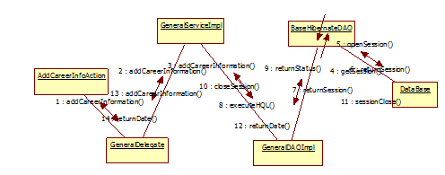
Add Career Information Details Collaboration Diagram

Slide 56
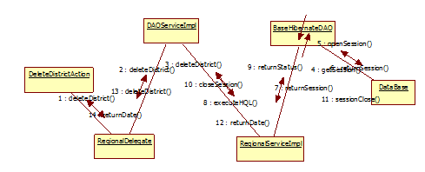
Delete District Details Collaboration Diagram

Slide 57
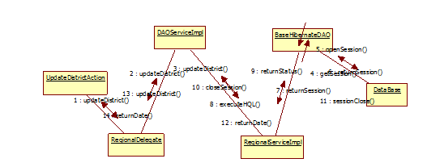
Update District Details Collaboration Diagram

Slide 58
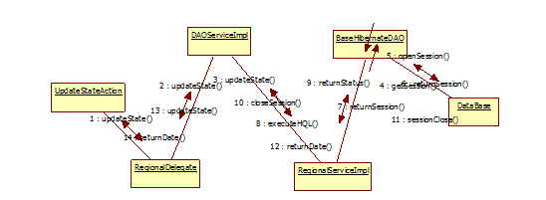
Update State Details Collaboration Diagram

Slide 59
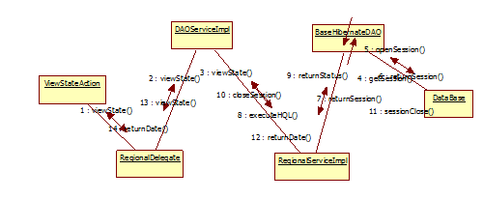
View State Details Collaboration Diagram

Slide 60
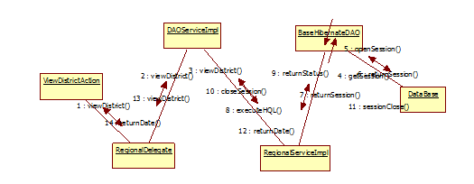
View District Details Collaboration Diagram

Slide 61
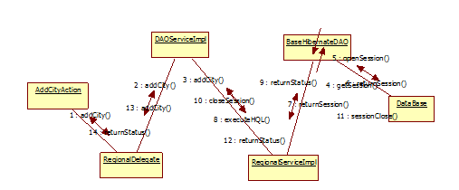
Add City Details Collaboration Diagram:

Slide 62
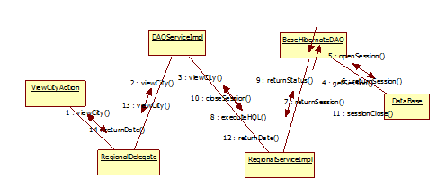
View City Details Collaboration Diagram

Slide 63
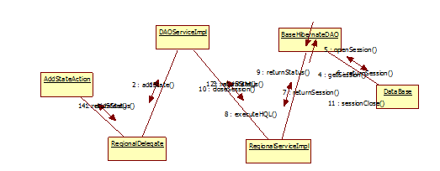
Add State Details Collaboration Diagram

Slide 64
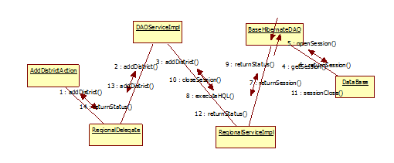
Add District Details Collaboration Diagram

Slide 65
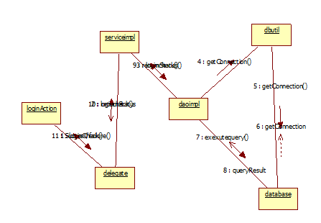
Login Sequence Collaboration Diagram :

Slide 66
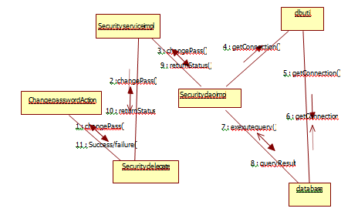
Change password SequenceCollabration diagram

Slide 67
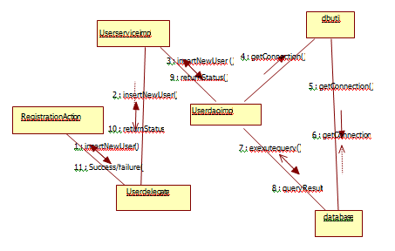
Registration Sequence CollbrationDiagram:

Slide 68
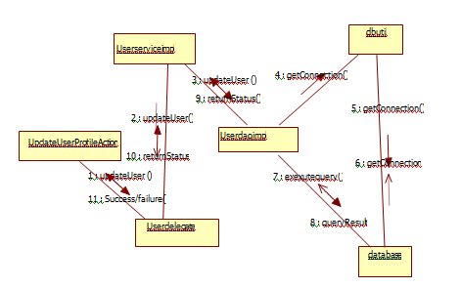
Update User Profile SequenceCollbration Diagram

Slide 69
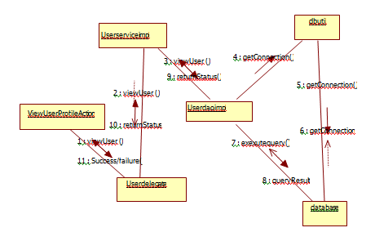
View User Profile Sequence Collaboration Diagram

Slide 70
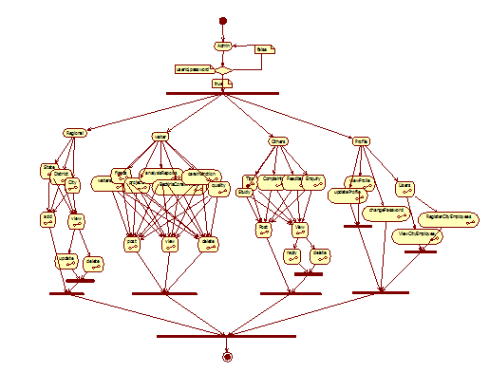
Activity Diagram for Admin :

Slide 71
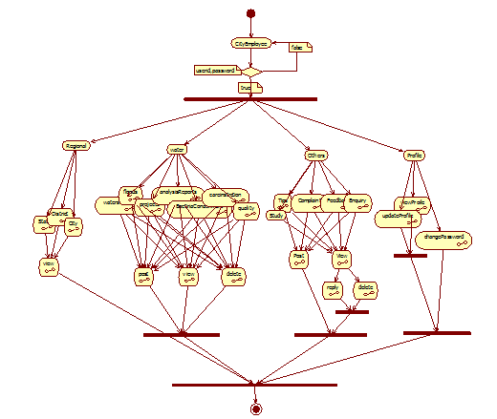
Activity Diagram for City Employees:

Slide 72
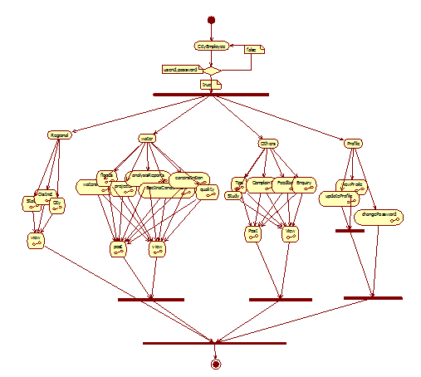
Activity Diagram for Citizen

Slide 73
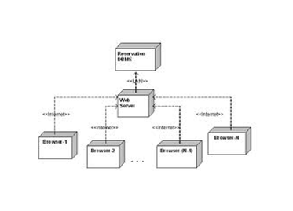
Component Diagram:

Slide 74
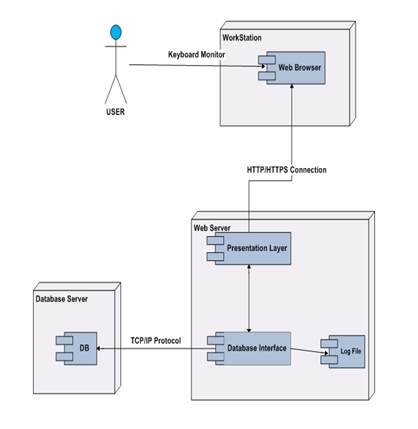
Deployment Diagram:

Slide 75
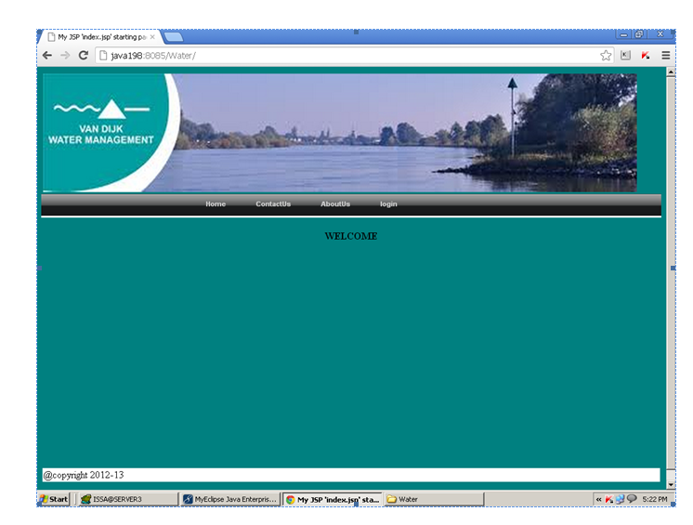
OUTPUT SCREENS:

Slide 76
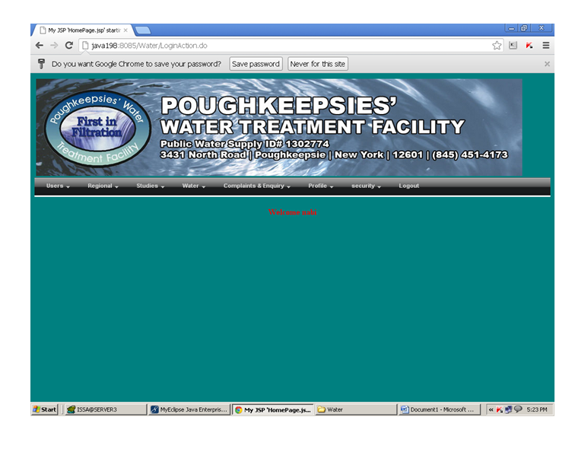

Slide 77


Slide 78


Slide 79


Slide 80


Slide 81


Slide 82


Slide 83


Slide 84


Slide 85


Slide 86
CONCLUSION:
WORK DONE:
The Water Management Portal was successfully designed and is tested for accuracy and quality.
During this project we have accomplished all the objectives and this project meets the needs of the organization. The developed will be used in searching, retrieving and generating information for the concerned requests.
GOALS
Reduced entry work
Easy retrieval of information
Reduced errors due to human intervention
User friendly screens to enter the data
Portable and flexible for further enhancement
Web enabled.
Fast finding of information requested

Slide 87
BIBILIOGRAPHY:
(1) Java Complete Reference by Herbert Shield
(2) Database Programming with JDBC and Java by George Reese
(3) Java and XML By Brett McLaughlin
(4) Wikipedia, URL: http://www.wikipedia.org.
(5) Answers.com, Online Dictionary, Encyclopedia and much more, URL: http://www.answers.com
(6) Google, URL: http://www.google.co.in
(7) The Complete Refernce Struts James Holmes
Struts: The Complete Reference, 2nd Edition - Free PDF Ebooks Download

